Slide 1
Final Project
Matthew Lonis – mrlonis@iu.edu
Student Presentation
B481 / Spring 2018

Slide 2
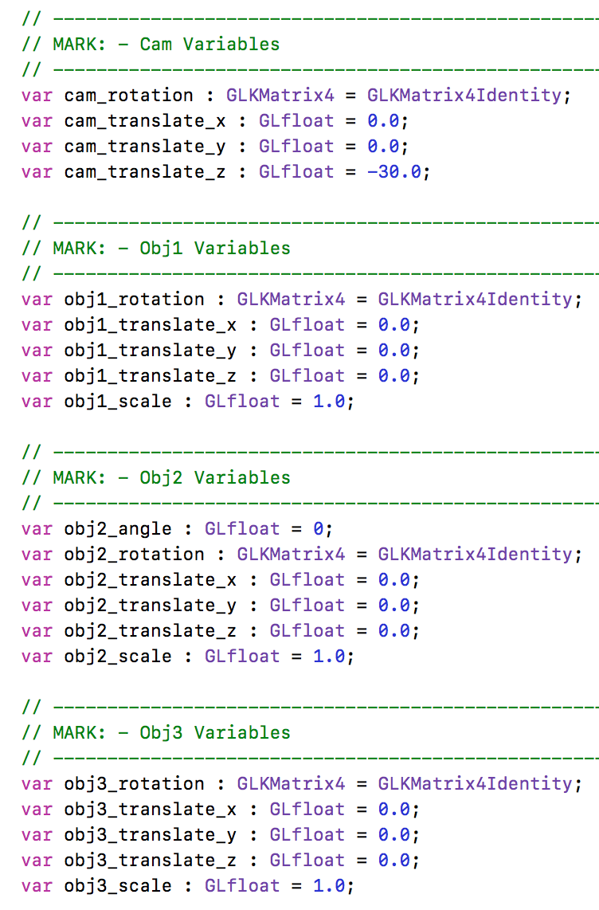
Camera & Object Interaction
Interaction is implemented in the same way as interaction in assignment 3 with the added obj2 and obj3 objects.
The camera interaction affects the viewing matrix and the object interaction affects the modeling matrix.
The interaction manipulates variables which are then used to build the required translation, rotation, and scaling matrices.

Slide 3
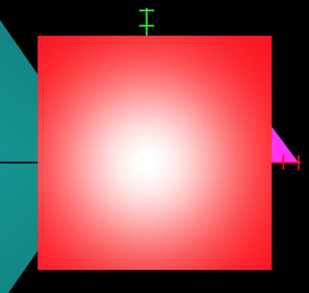
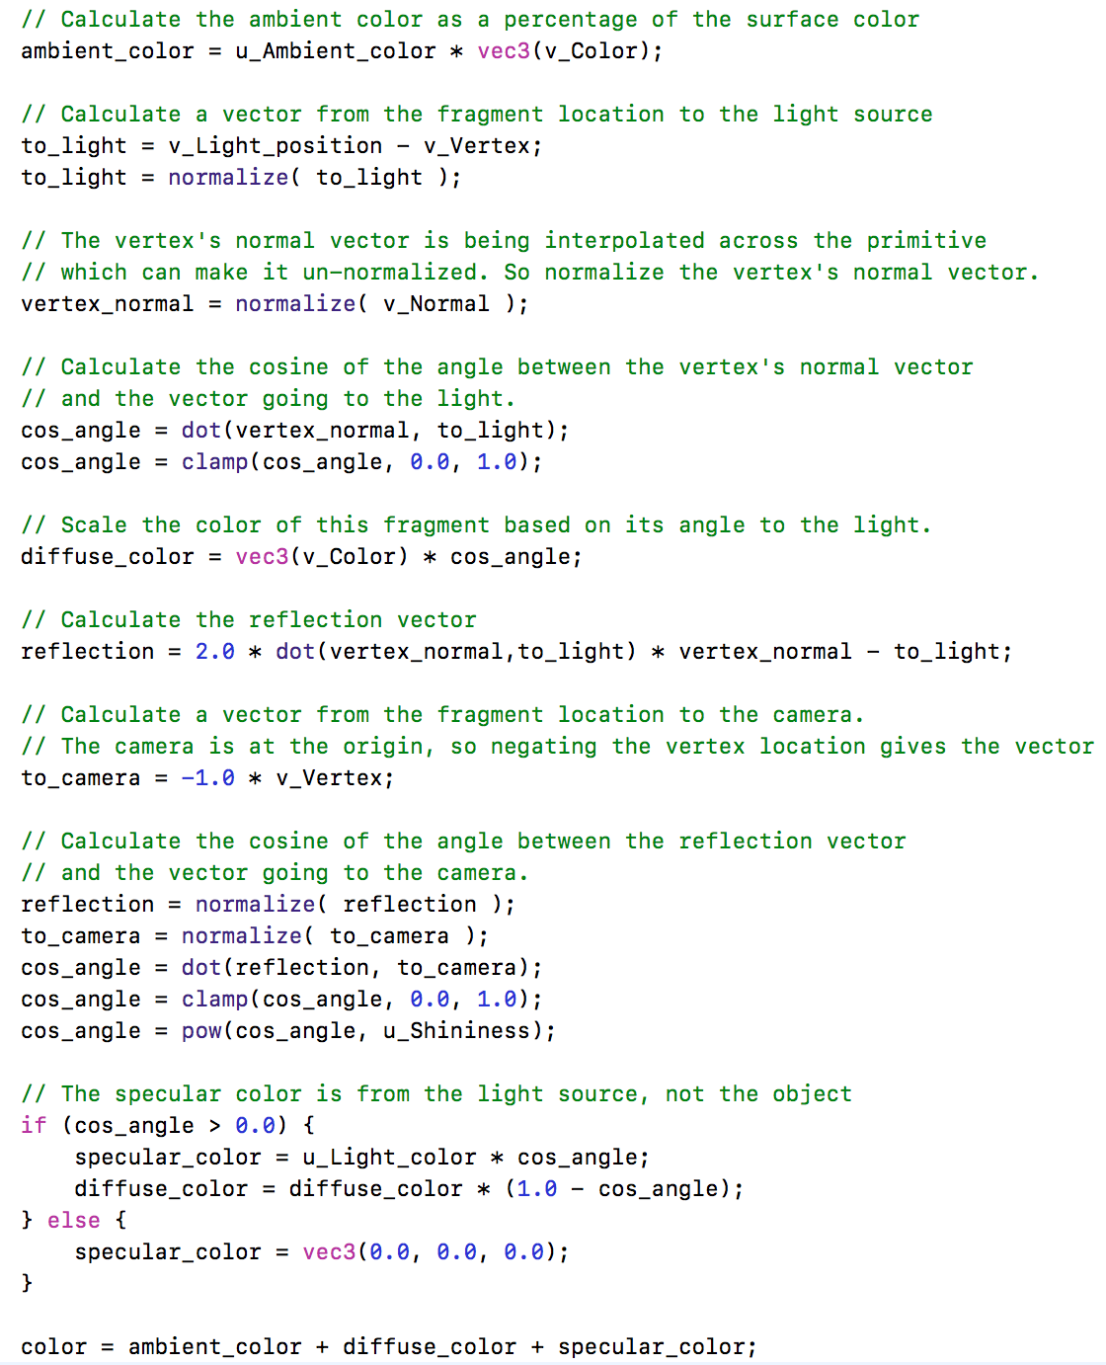
Lighting
My project implements specular, diffuse, and ambient lighting.
This all takes place in the fragment shader in order to provide interpolation and a smoother lighting.
This implements the Phong reflection model.
I found this to be a much more appealing lighting technique.

Slide 4
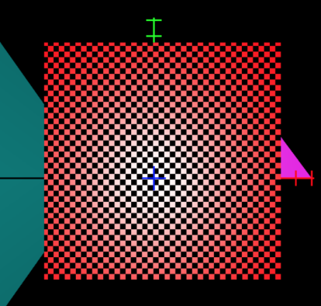
Texturing
My texturing in this project follows the same implementation of lab14 sample code.
This made it easy to follow since I did my project in Swift and produced quick results allowing me to focus on lighting and interaction.
I texturized my obj1 (a cube) on all sides as shown in the picture below.

Slide 5
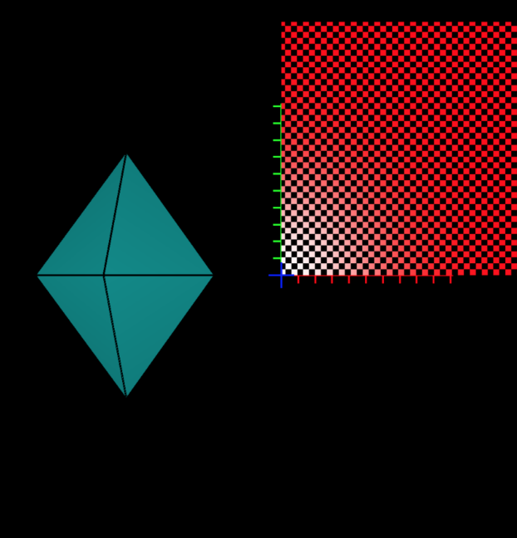
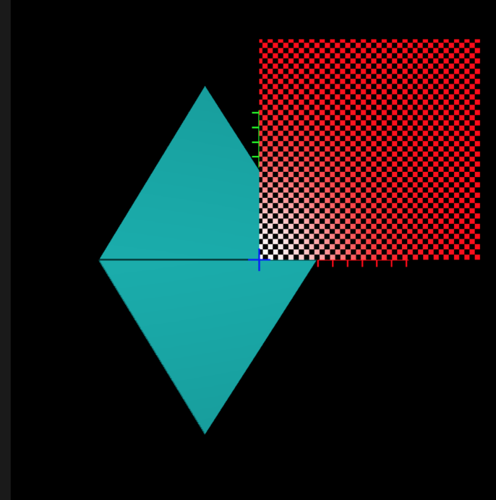
Animation
I implemented animation in my project by rotating my obj2 (a diamond) around an axis.
Since we still have time before our final project submission I am planning on attempting to animate my light source (recommended to me by John).

Slide 6
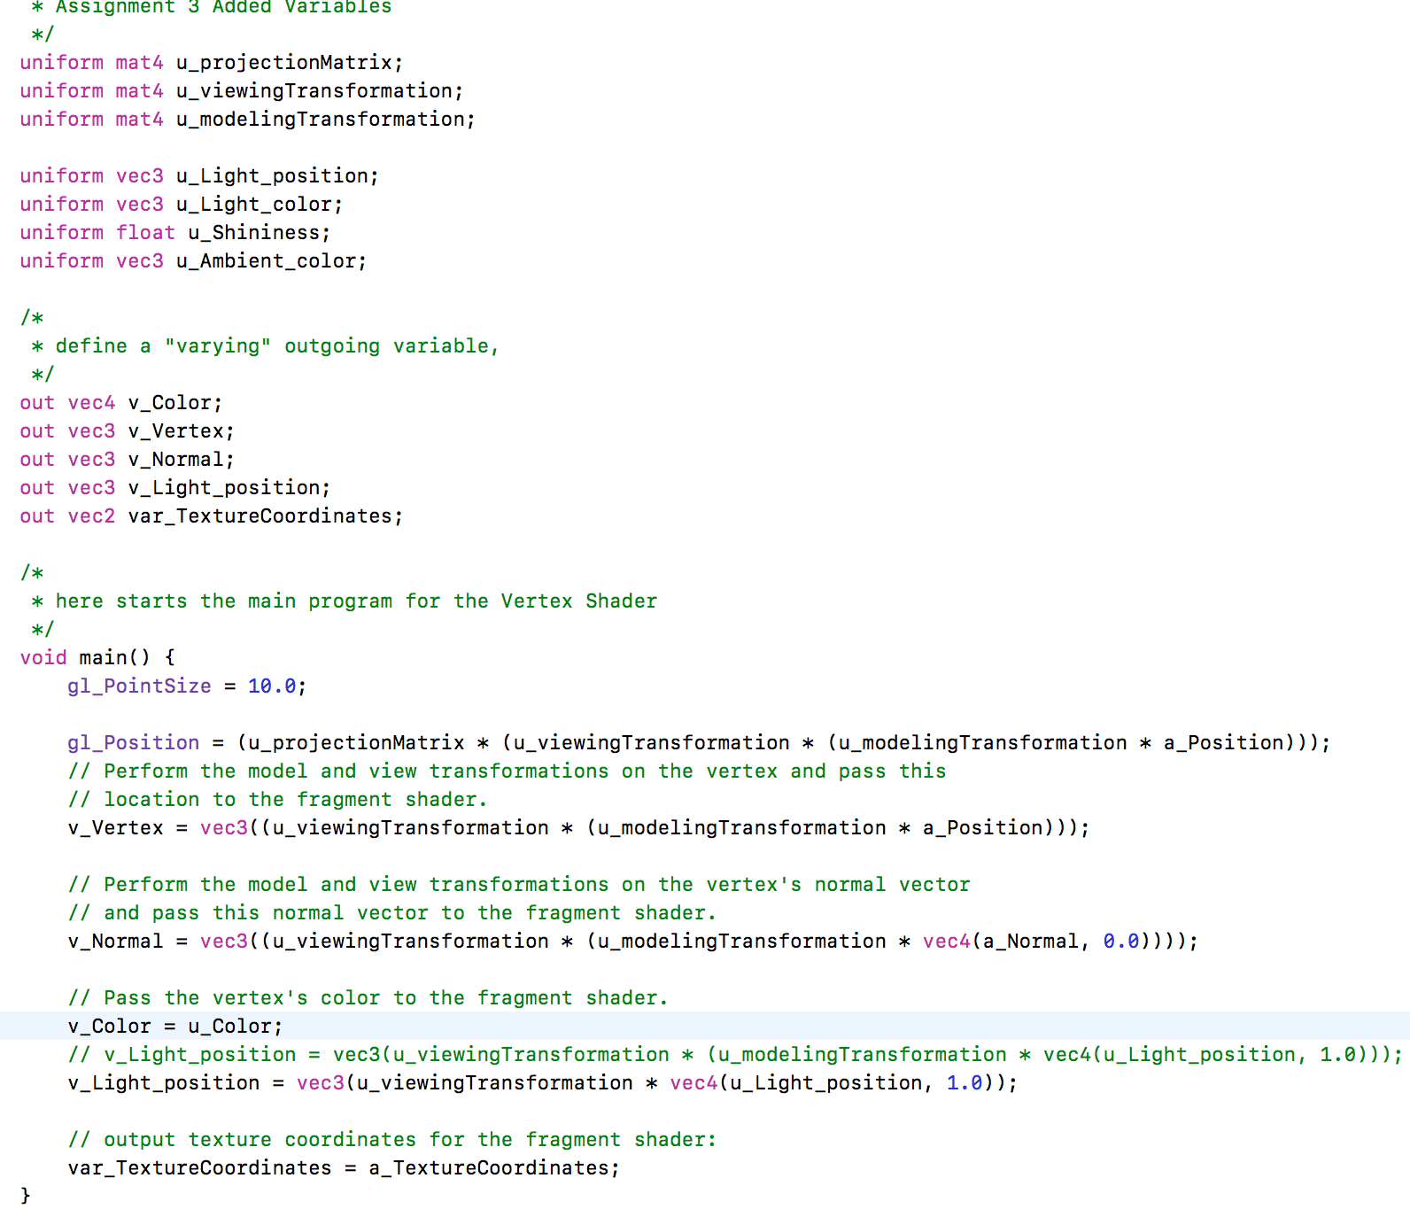
Vertex Shader
I have already included a picture of almost ALL of my fragment shader code but here is my Vertex shader code.

Slide 7
Conclusion
I still have more things I want to do.
I want to speed up the performance of my app by not calculating GLKMatrix4s every call to GLKview.
I want to try to animate my light source.
I want to experiment with more mapping on more objects.

